Slide 1

HUMAN AWARE ROBOT NAVIGATION
BY: ANIKET PATIL
DENNY BOBY
NIHAL SUNEEL NAVALE
Github Link: https://github.com/dennyboby/human_aware_robot_navigation

Slide 2
Table of Contents
1
6
2
7
3
8
4
9
5
10
Problem Description
Results
Application Impacts
Devices
Related Work
Objectives for Learning
Proposed Method
Deliverables
Experiments
Team and Task Division
Notes:
In this presentation we will mainly be covering Problem Description, Application Impacts, Proposed method, Experiments and Preliminary results.

Slide 3
1
Problem Description

Slide 4
Problem Description
Our project aims to address the navigation complexity of robots amid humans.
The robot is set in an hospital environment and our aim is to develop a navigation stack to enable the robot to navigate amongst nurses and various objects which one might find in a hospital.
Notes:
Our problem focuses on the robot navigation problem around humans. And this project focuses on hospital environment

Slide 5
2
Application Impacts

Slide 6
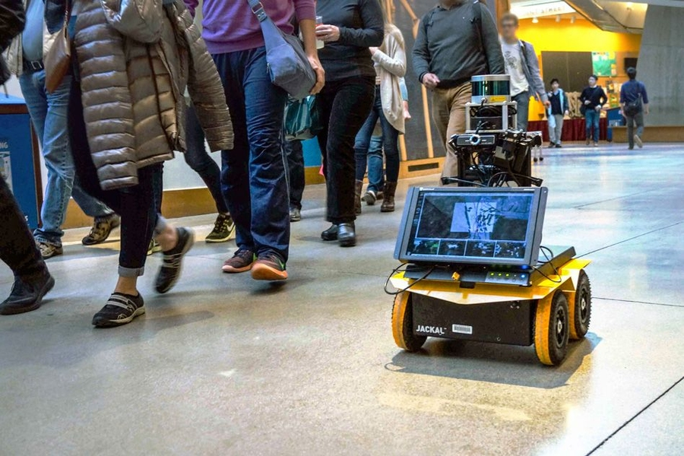
Application Impacts
Will help integrate robots into our lives better.
Has the potential to be used in the:
Hospitality industry
Education sector
Medical industry
Warehouse automation
Future space exploration
It also has a huge potential in autonomous vehicles development.
Notes:
Successful implementation of our project and related projects will help integrate robots into our society and lives better.
Robots can be used to navigate scenarios such as a Hospitality, Schools, Medical, Warehouses and even space explorations.
Dynamic obstacle avoidance also has huge potential in the autonomous vehicle development, companies such as waymo, cruise and tesla use various motion planning methods to achieve this task.
Waymo has been working with APF methods for obstacle avoidance.

Slide 7
3
Related Work

Slide 8
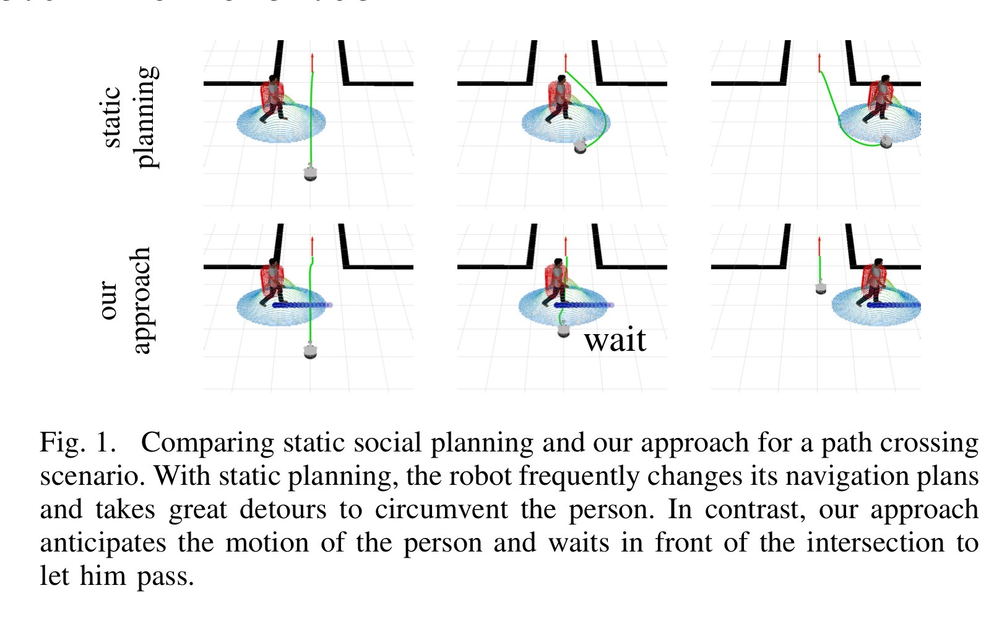
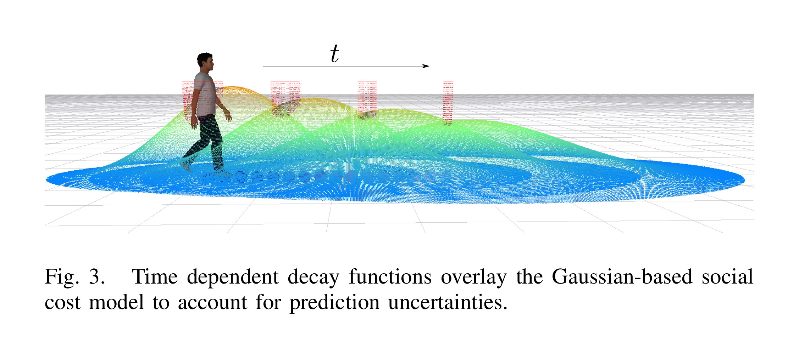
Related Work
Time Dependent Planning on a Layered Social Cost Map for Human-Aware Robot Navigation
Marina Kollmitz, Kaijen Hsiao, Johannes Gaa and Wolfram Burgard (2015)
Presents a novel, planning based approach for social robot navigation.
Combines time-dependent A*, search based path planning with dynamic, social cost maps and a Gaussian social cost model.
Notes:
This paper was the inspiration for this implementation. It talks about how gaussian function based costmaps can be used to implement robot trajectories to avoid collision with humans. Their experiments were performed in RViz using deterministic A* algorithm.
This paper is one of the fundamental methods that inspired our project, this paper presents a novel, planning-based approach for social robot navigation. It uses predicted human trajectories and a social cost function to plan collision-free paths that take human comfort into account. It furthermore employs time dependent, kinodynamic path planning to reason about human motion over time and to account for the kinematic and dynamic constraints of a robot. Their approach generates paths that exhibit properties similar to those used in human-human interaction, such as waiting for a human to pass before continuing along an intended path, avoiding getting too close to another human’s personal space, and moving out of the way when blocking a human’s path.
They use time dependent, deterministic planning (A*) to reason about the spatial relationship of a robot and humans with respect to time.

Slide 9
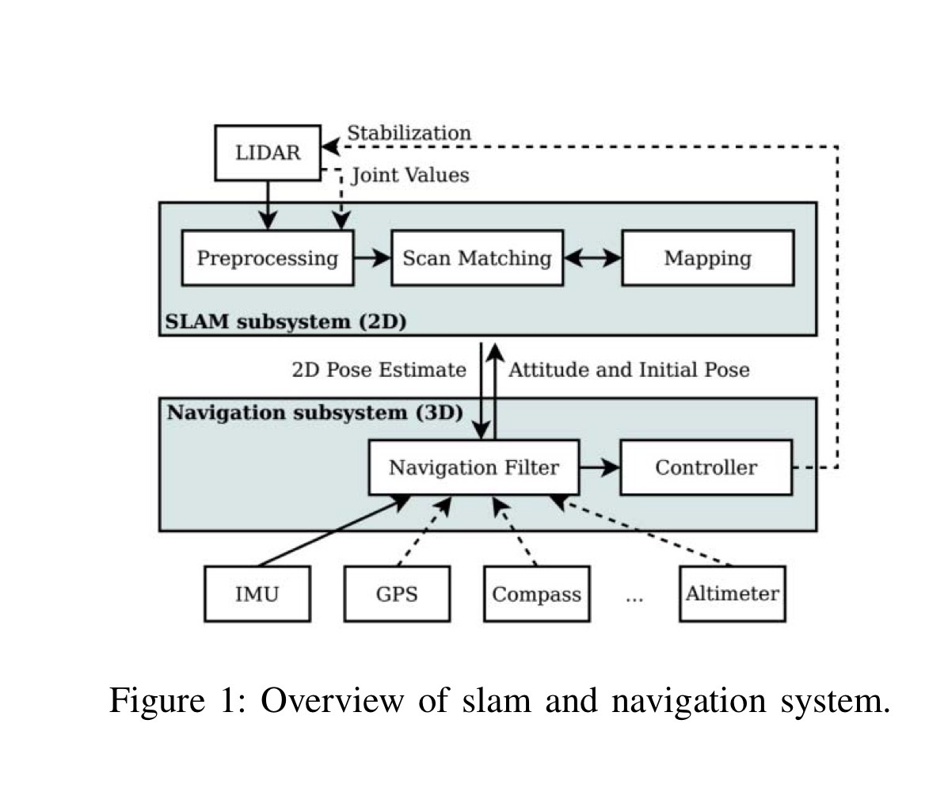
Related Work
2D Map Building and Path Planning Based on LiDAR
Chi Zhang, Junzheng Wang, Jing Li, Min Yan (2017)
Presents a method which employs LiDAR to construct a 2D map.
To enhance efficiency of dynamic planning, this work combines AD* with DWA.
Global Grid Map - SLAM
Localization - AMCL, GPS
Global Path Planning - AD*
Local Path Planning - DWA
Notes:
This paper is another fundamental method which we refer, this paper presents a method of map building and path planning in an unknown environment. The method employs Light Detection And Ranging (LiDAR) to construct the 2D grid map, on which Anytime D* (AD*) and Dynamic Window Approach (DWA) are used for path planning. The global path is generated by AD* algorithm while DWA is responsible for dynamic obstacle avoidance.
Global Grid Map - SLAM
In this paper, they employed the 2D simultaneous localization and mapping (SLAM) system for environment perception and real-time map building.
Localization - AMCL (Adaptive Monte Carlo localization), GPS
For the known global map, this paper utilizes the adaptive Monte Carlo localization approach (AMCL), which is a probabilistic localization system, to track the robot’s attitude in an indoor environment. For outdoor circumstance, the Global Positioning System (GPS) is exploited to provide an accurate position.
Global Path Planning - AD*
Local Path Planning - DWA
This paper employs DWA to realize dynamic obstacle avoidance and local path planning. DWA samples multiple sets of speeds in the velocity space and calculates the states at each speed during at a time interval.

Slide 10
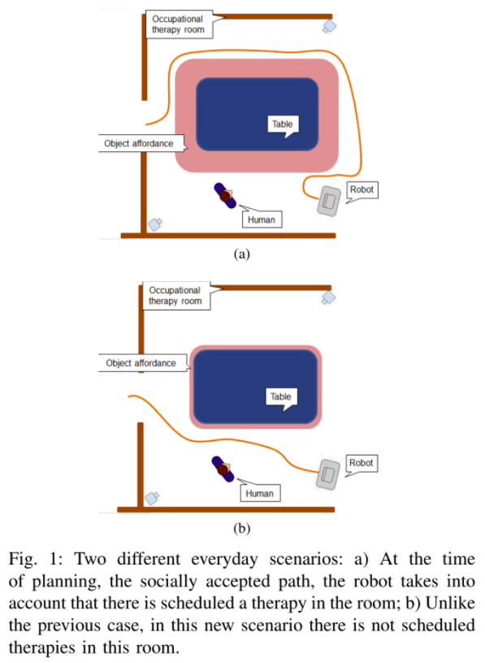
Related Work
Human-aware Robot Navigation based on Time-dependent Social Interaction Spaces: a use case for assistive robotics
A. Vega-Magro, L.V. Calderita, P. Bustos, P. Nu ́nez (2020)
This article presents a first approach to the idea of time-dependent social mapping, where the planning of the social route by the robot takes into consideration variables that depend on the time and schedules of use of certain spaces.
The classical Dijkstra algorithm is employed for determining the shortest path between an initial position and a target to which the robot must travel.
Notes:
Currently, navigation algorithms do not take into account the social complexity of the scenarios like, for example, their relationship with the hour of the day or the activities carried out in these scenarios. This article presents a first approach to the idea of time-dependent social mapping, where the planning of the social route by the robot takes into consideration variables that depend on the time and schedules of use of certain spaces.
To this end, this article describes how the spaces of human-object interaction vary as a function of time and how this affects the social navigation planned by the robot.
The classical Dijkstra algorithm is employed for determining the shortest path between an initial position and a target to which the robot must travel.

Slide 11
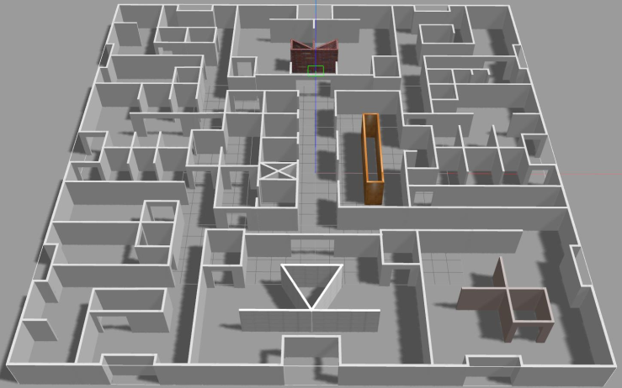
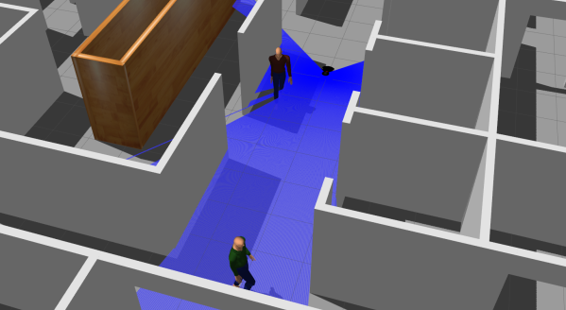
Related Work
MRPB 1.0: A Unified Benchmark for the Evaluation of Mobile Robot Local Planning Approaches
Jian Wen, Xuebo Zhang, Qingchen Bi, Zhangchao Pan, Yanghe Feng, Jing Yuan, and Yongchun Fang
Compares the performance of TEB and DWA local planner for a differential drive robot in different scenarios.
In this paper they evaluate the performance of both planner in the field of efficiency, safety and flexibility of the path taken.
Notes:
This paper does a performance comparison between DWA and TEB local planner for differential drive mobile robot.
The comparisons were made for efficiency, safety and flexibility.
Efficiency:
In terms of efficiency the experimental results indicate that planning with TEB is 8.94 times faster than planning with DWA.
Safety:
In terms of safety TEB achieves better security performance in most test scenarios because of the better clearance from obstacles
but the total travel distance of TEB is relatively longer than that of DWA.
Flexibility:
In terms of flexibility of path, experimental results indicate that TEB performs better flexibility than DWA especially in scenarios like mazes that require robots to turn continuously.

Slide 12
4
Proposed Method

Slide 13
Proposed Method
The method flow is as follows:
Mapping: Use slam_gmapping library for mapping
Costmap Layers:
Static Layer
Obstacle Layer
Inflation Layer
Social Layer
Global Planner:
Global Planner Package (Dijkstra)
Time Based Lattice Planner (Timed A* Planner)
Local Planner:
DWA planner
TEB planner
Timed Path Follower
Notes:
Method flow is as follows: first we do mapping.
Mapping: We mapped map the unity hospital scenario using slam_gmapping library.
slam_gmapping:
Costmap Layers:
Then we added different costmap layers for obstacle avoidance and human aware robot navigation while planning the path to goal. Some costmap layers are static layer, obstacle layer, inflation layer and social layer. Details of it will be discussed in the next slide.
Global Planner:
Then we added a global planner to plan a path from start to goal and compare performance of these planners for different scenarios like replanning global path when a dynamic obstacle completely blocks a path in narrow passages. We used global planner package for baseline which uses Dijkstra for finding the shortest path and for human aware navigation we used Time based lattice planner which is timed A* planner considering constraints of the robot.
Local Planner:
Then we added a local planner for dynamic obstacle avoidance and path following. Based on the literature review we found that TEB local planner is better compare to DWA. Using TEB local planner as the base framework we want to compare the performance of Timed Path Follower in terms of the social aspect of navigation amongst humans.

Slide 14
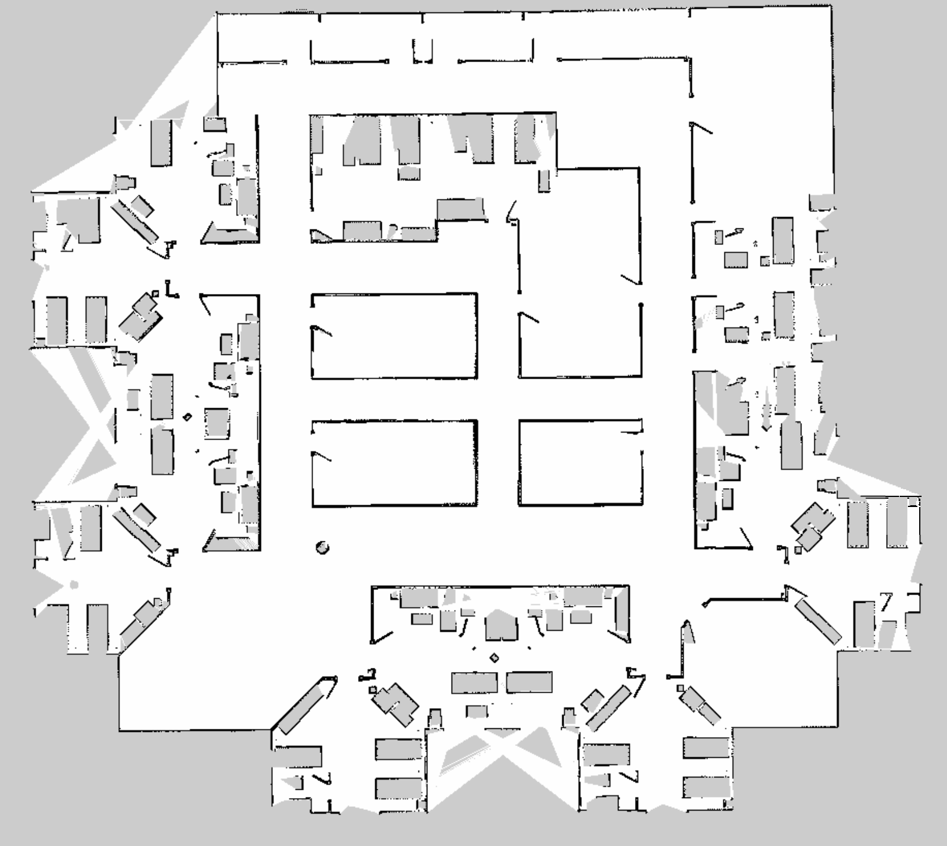
Mapping
A static map of the hospital environment is required for navigation
Using slam_gmapping package of ROS, we map the hospital environment
Input: laser scan data and robot odometry
Output: Predicted occupancy map of the environment
Gmapping uses Particle Filter approach to implement SLAM
Notes:
For navigation, the map server in ROS requires a static map of the environment. We mapped the hospital environment using slam_gmapping package of ROS, which takes the laser scan data and robot odometry as the input and produces the 2D occupancy map of the environment as output. It is based on the particle filter approach for SLAM implementation.

Slide 15
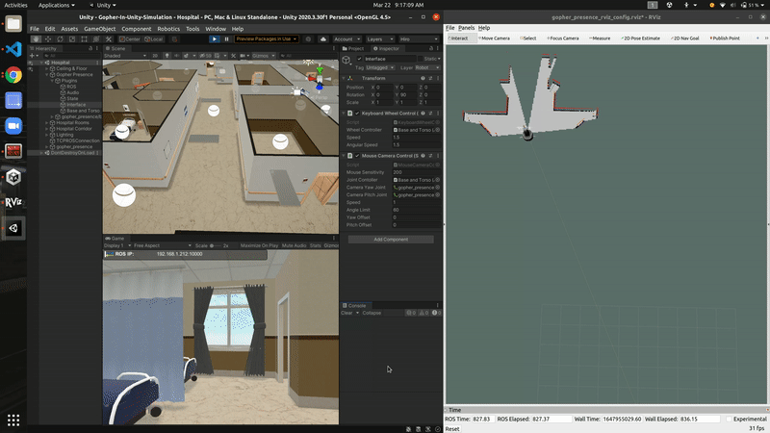
Demo - Mapping
Notes:
Here, we can see the hospital environment being mapped using the keyboard interface.

Slide 16
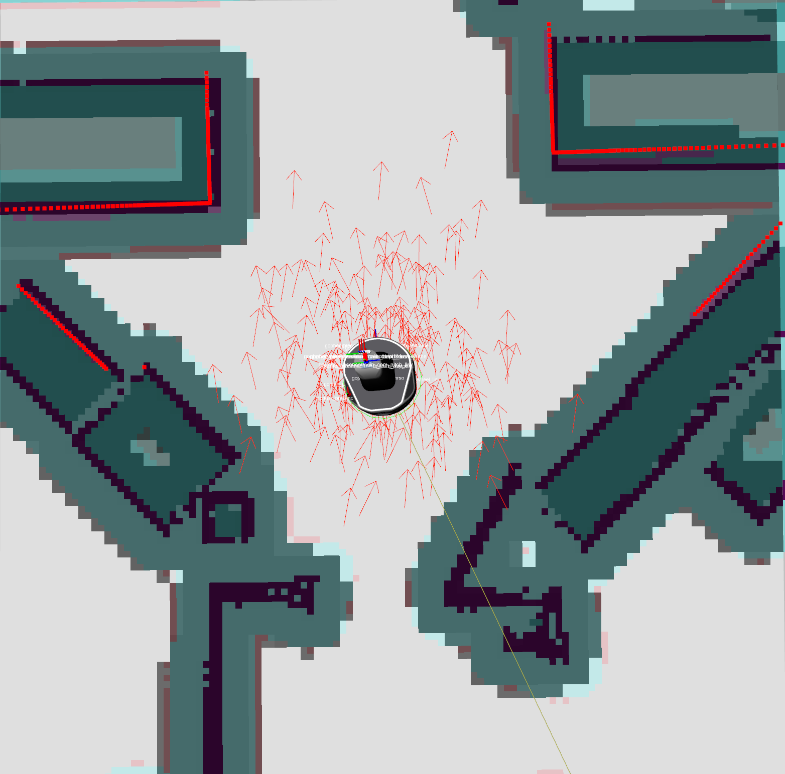
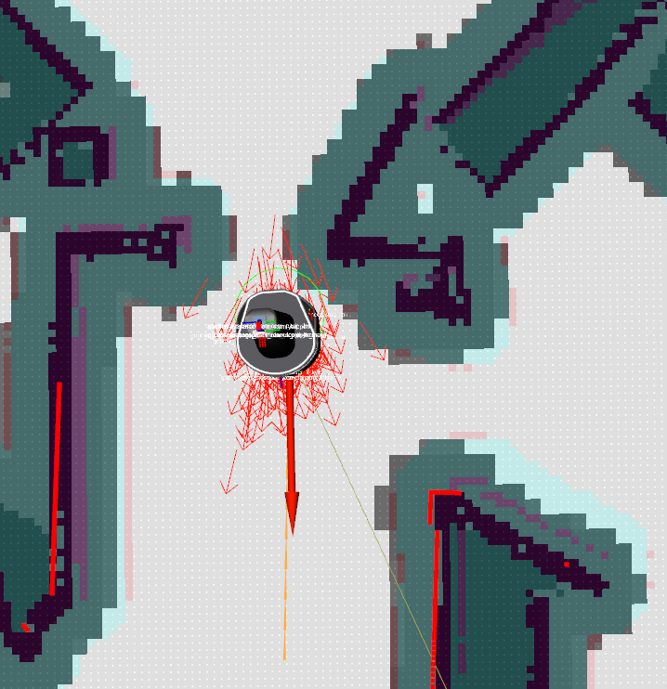
Localization (AMCL)
Input: Static map, laser scans, and tf (transformation between links)
AMCL (Adaptive Monte Carlo Localization) figures out robots position in the static map based on the laser scan.
Output: Estimation of robot position
Notes:
AMCL takes in a static map, laser scans, and tf, and outputs pose estimates. It implements the adaptive (or KLD-sampling) Monte Carlo localization approach, which uses a particle filter to track the pose of a robot against a known map.

Slide 17

Costmap Layers
For Human-aware Navigation
Baseline
Static Layer
Obstacle Layer
Inflation Layer
Social Layer
Notes:
Coming to the costmap layers:
The baseline implementation uses 3 costmaps;
The Static Layer includes the occupancy grid that was generated during the mapping stage
The Obstacle Layer consists of obstacles that are observed by the laser scanner, which are not present in the initial occupancy grip map
The Inflation Layer consists of inflation around the obstacles from both static and obstacle layers. This inflation can be configured in the costmap parameters configuration file.
In our implementation, in order to take into consideration dynamic obstacles, we add another layer called the Social Layer which considers the current as well as predicted position of the dynamic obstacles in the environment.

Slide 18
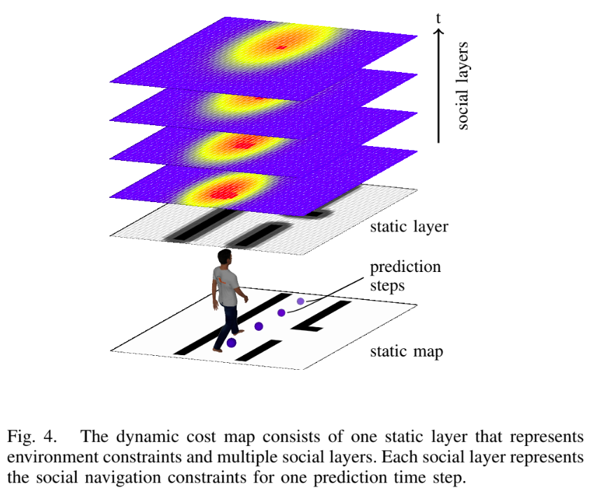
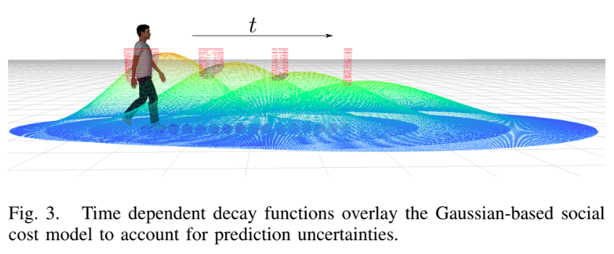
Social Layer
Notes:
In this implementation a social cost model represents the social space preferences of humans. The model is based on gaussian distribution and standard deviations along the person’s front and side, that is shown in fig 3.
We can see a red pillar around the person, this is a non-traversable area around the person’s center and accounts for the physical outline of the person, and any paths traversing through this area are pruned directly during planning because they would result in collision.
We used a layered dynamic cost map to represent static environment and time dependent social constraints. It consists of one static layer and multiple dynamic layers as shown in fig 4. The layers are generated by using static social costmap over time t and (t+1).

Slide 19
Global Planners

Slide 20
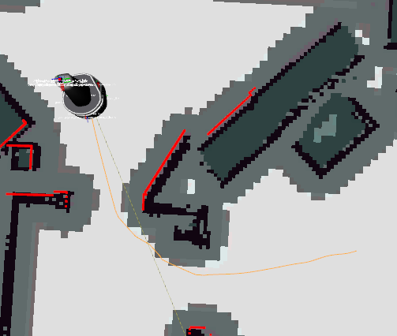
Base Global Planner (Dijkstra)
Input: All global costmaps layers, robot pose and goal pose
Uses Dijkstra algorithm to find the shortest path from start to goal.
Output: Optimal path to goal

Slide 21

Time Based Lattice Planner
State Lattice based global planner, where the task space is discretized into nodes
The possible paths are generated taking into consideration the dynamic constraints of the differential drive robot
lattice_planner package provides a move_base global planner plugin for a time-bounded A* lattice planner
Notes:
Lattice planner is a global planner which generates a trajectory by discretizing the task space of the robot into several nodes.
The paths are generated by combining a series of "motion primitives" which are short, feasible and smooth motions based on the robot’s dynamic constraints.
In our project we are using the lattice_planner package developed for the move_base navigation stack by Kollmitz and co-researchers.
In their implementation they used a Gazebo environment, but since we are using Unity we had to make significant changes in our approach to incorporate the time-based lattice planner.

Slide 22
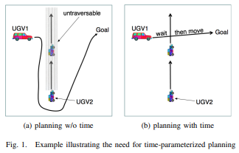
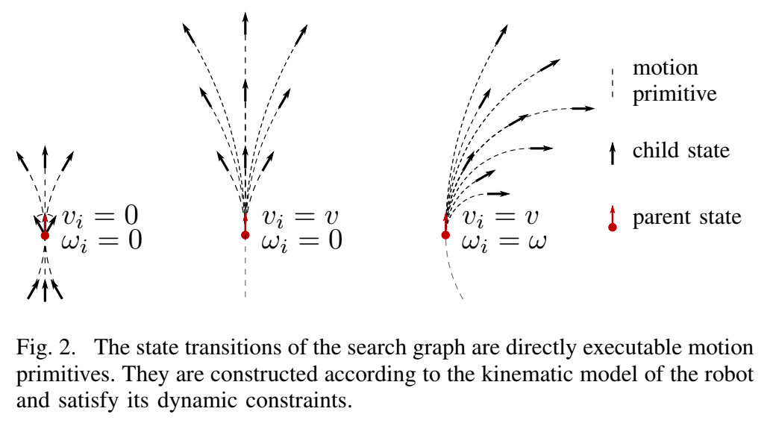
Time Based Lattice Planner
Time-parameterized deterministic A* planning .
Takes into consideration future time predictions into considerations to plan trajectory accordingly
Notes:
We use time dependent, deterministic A* to reason about the spatial relationship of the robot and humans with respect to time.
Adding time dependence to planning space introduces additional complexity to the planning process. The planned, time dependent trajectories have to be feasible to ensure that the robot can follow the planned trajectory in time. The reachable robot configurations within a time interval depend upon current pose and velocity and its dynamic constraints.
The figure in the right gives a nice example of how time-based lattice planner works. A global planner would plan around the dynamic obstacle to reach the goal whereas the time based lattice planner can consider the time parameter, and plan a trajectory which includes waiting for a dynamic obstacle to pass.

Slide 23
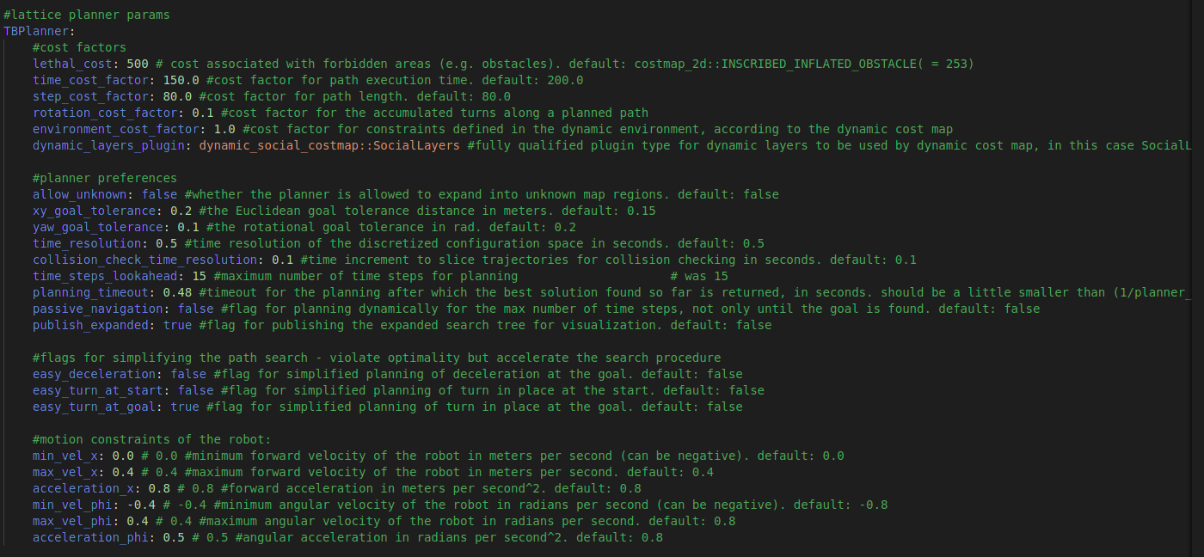
TB Lattice Planner parameters

Slide 24
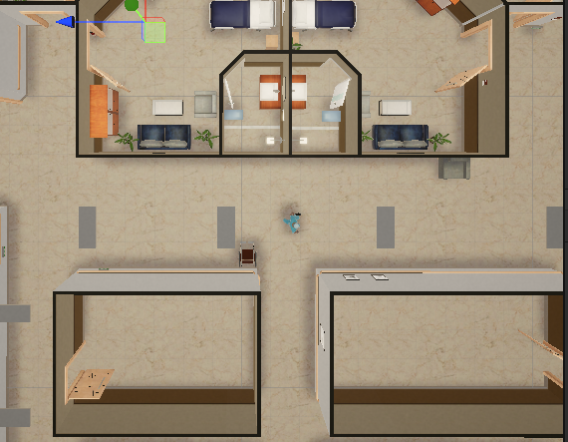
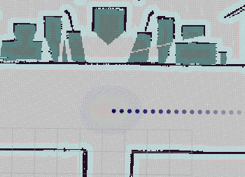
People Motion Prediction
Time based lattice planner uses future positions of human to plan its path.
Constant velocity prediction node: Predicts and publishes position of human for n time steps.
Unity people publisher script: Publishes current human pose and velocity.
Ideal Case: Node uses laser scanner to detect human legs to predict pose and velocity.
Notes:
Time based lattice planner uses future positions of the human to plan its path and replan. Unity people publisher script publishes the current position and velocity of the human to the people topic. Constant velocity prediction node reads people topic and computes position of human for n time steps and publishes it to people prediction topic. This topic is subscribed by time based lattice planner. Ideally a node should detect human legs from laser scanner and find the pose and velocity of human instead of it being published from unity. We tried that method but it didn’t give expected results.

Slide 25
Local Planners

Slide 26
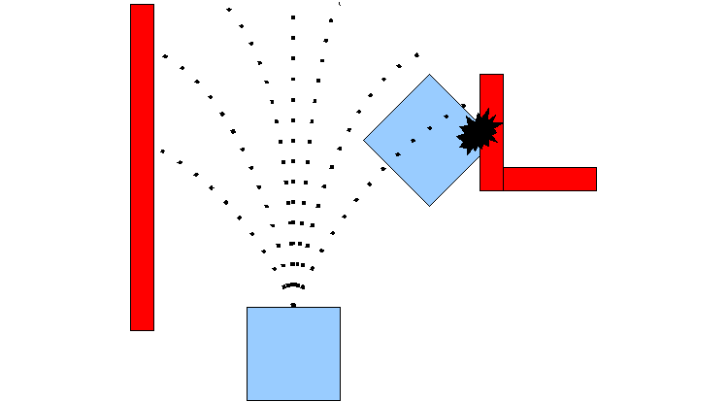
DWA Planner
Uses dwa_local_planner package in ROS
Key approach:
Sample robot’s control space
Obtain sampled velocity in robot’s control space, within the dynamic constraint
Perform forward simulation, to predict trajectory
Evaluate each trajectory based on various parameters such as proximity to obstacles, goal, bias towards global path, speed
Pick highest scoring trajectory and navigate
Notes:
The dwa_local_planner package provides a controller that drives a mobile base in the plane. Using a map, the planner creates a kinematic trajectory for the robot to get from a start to a goal location.
The basic idea of the Dynamic Window Approach (DWA) algorithm is as follows:
1. Discretely sample in the robot's control space (dx,dy,dtheta)
2. For each sampled velocity, perform forward simulation from the robot's current state to predict what would happen if the sampled velocity were applied for some (short) period of time.
3. Evaluate (score) each trajectory resulting from the forward simulation, using a metric that incorporates characteristics such as: proximity to obstacles, proximity to the goal, proximity to the global path, and speed. Discard illegal trajectories (those that collide with obstacles).
4. Pick the highest-scoring trajectory and send the associated velocity to the mobile base.
5. Rinse and repeat.

Slide 27
DWA Parameters
Robot configuration Parameters: velocity, acceleration thresholds
Goal Tolerance Parameters: Tolerance for “goal reached” condition
Forward Simulation Parameters:
sim_time
vx_samples, vy_samples, vth_samples
Trajectory Scoring Parameters:
path_distance_bias
goal_distance_bias
forward_point_distance
stop_time_buffer
Notes:
We will see some of the key parameters that were required while tuning the DWA planner.
Robot configuration parameters depend on the the maximum velocity and accelerations based on hardware constraints of the robot.
Goal tolerance, as the name suggests, decide the tolerance for making the decision whether the robot has reached the goal.
Forward Simulation parameters are important for DWA algorithm, as they decide the time steps for which we find the sampled velocities, and the number of velocity samples in the x, y and theta domain.
Finally, once the trajectories are generated, we need to evaluate them based on certain criteria and eliminate invalid trajectories. This criteria is defined in Trajectory Scoring Parameters.

Slide 28
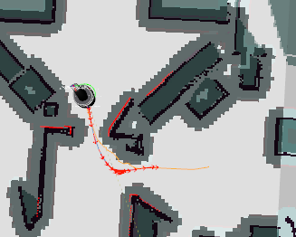
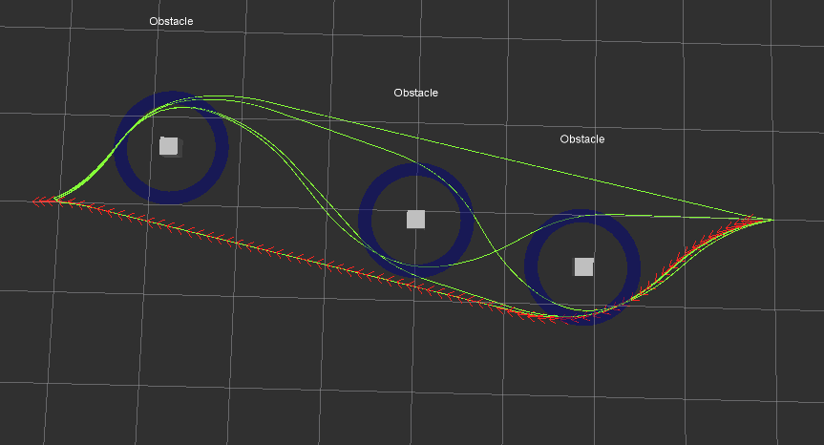
TEB Planner
Uses teb_local_planner package in ROS
Key approach:
Get trajectory from global planner
Optimize path for:
Execution time
Separation from obstacle
Compliance with kinodynamic constraints
Subset of admissible trajectories of distinctive topologies are optimized in parallel.
If stuck at local minima switch to current globally optimal trajectory among the candidate set.
Notes:
The teb_local_planner package implements an online optimal local trajectory planner for navigation and control of mobile robots as a plugin for the ROS navigation package.
The basic idea of the Time Elastic Bands (TEB) algorithm is as follows:
1. It gets the initial trajectory from global planner.
2. The path is optimized during runtime w.r.t. minimizing the trajectory execution time (time-optimal objective), separation from obstacles and compliance with kinodynamic constraints such as satisfying maximum velocities and accelerations.
3. A subset of admissible trajectories of distinctive topologies is optimized in parallel. Distinctive topologies are obtained by utilizing the concept of homology / homotopy classes.
4. When stuck at local minima the planner is able to switch to the current globally optimal trajectory among the candidate set.

Slide 29
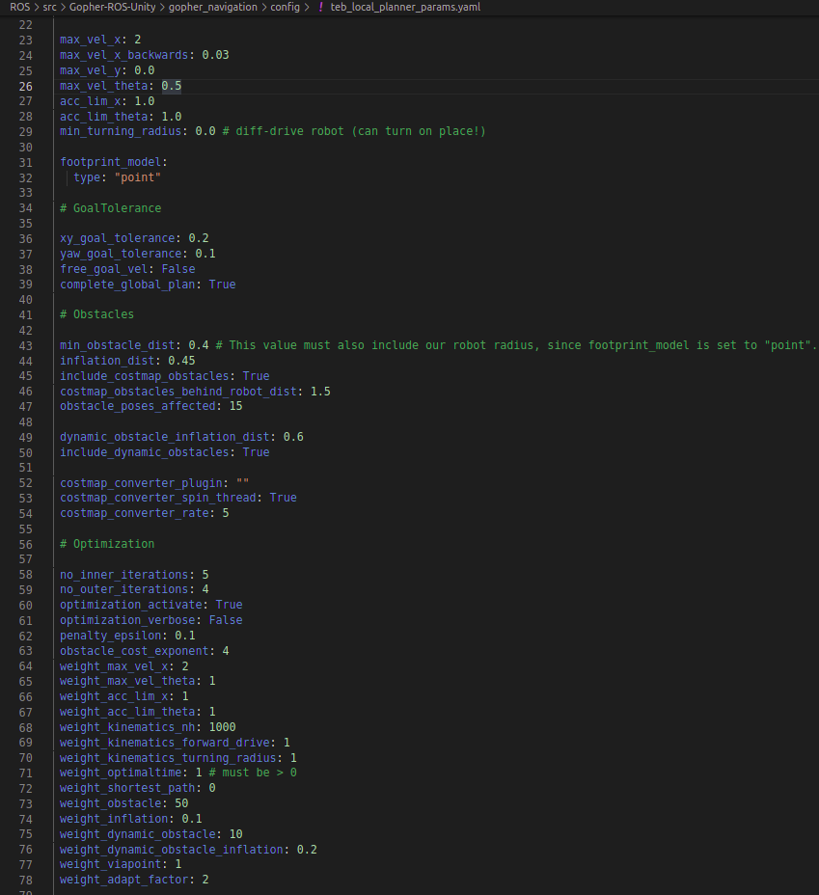
TEB parameters
max_vel
acc_lim
xy_goal_tolerance
min_obstacle_dist
Weights of optimization
And more…
Notes:
Here we tune parameters such as velocity, accelerations, xy_goal_tolerance, inflation distance and more.
I’ll give a brief description of a few parameters:
velocity - this has to tuned to the physical constraints of the robot
xy_goal_tolerance - this defines a certain tolerance from the exact goal where the robot has to reach.
min_obstacle_dist- defines the distance that the robot has to maintain to avoid the obstacle.
A lot of times the planner fails to plan fast enough, one way we can overcome this is by increasing the lookahead region of the local planner, the lookahead region is the white square around the robot.
Another way we can improve planning is by increasing the update rate.

Slide 30
DWA and TEB Planner
DWA Planner Dynamic Window Approach | TEB Planner Timed-Elastic-Band
Performs a sample based optimization. | Primarily tries to seek for the time-optimal solution.
Suboptimal solutions without motion reversals. | Planning of multiple trajectory candidates in multiple topologies.
Well-suited for diff-drive/omnidirectional robots, but not for car-like robots. | Suited for all robot types.
Low computational burden. | Large computational burden.
The overall idea of both DWA and TEB is to predict/plan the motion of the robot along a given horizon while minimizing a given objective function and while adhering to kinodynamic constraints of the robot.
http://files.davidqiu.com/research/tutorials/2018_rosmann_Difference%20between%20DWA%20and%20TEB%20local%20planners.pdf

Slide 31
Timed Path Follower
Available as a Local planner plugin for the ROS navigation stack.
Based on Feedback Motion Controller
Note: In this implementation, the local planner is only concerned with following a given robot trajectory as closely as possible, it does not perform any collision checking. Controller frequency needs to be high enough to track changes in the global path.
Everytime an obstacle is encountered, the global planner replans. The local planner needs to quickly update the trajectory based on the new global trajectory.
Notes:
The timed_path_follower package provides a local planner plugin for the ROS navigation stack.
The local planner implements a controller for robots with differential drive constraints to follow time dependent, dynamically feasible navigation paths. It is based on a feedback motion controller for differential drive robots.
Note that the local planner is only concerned with following a given robot trajectory as closely as possible, it does not perform any collision checking.

Slide 32
Timed Path Follower Parameters
The following parameters configure the behavior of the path follower:
allow_backwards --> to allow backwards motion when trying to follow a trajectory.
xy_goal_tolerance --> euclidian goal distance threshold in meters.
yaw_goal_tolerance --> rotational goal distance threshold in radians.
It also has some controller gains and velocity bounds which can be dynamically reconfigured:
max_vel_x, max_vel_phi : bounds for forward and rotational velocities
k_rho: controller gain for distance
k_alpha: controller gain for angle to face next waypoint
k_beta: controller gain for angle diff to next waypoint

Slide 33
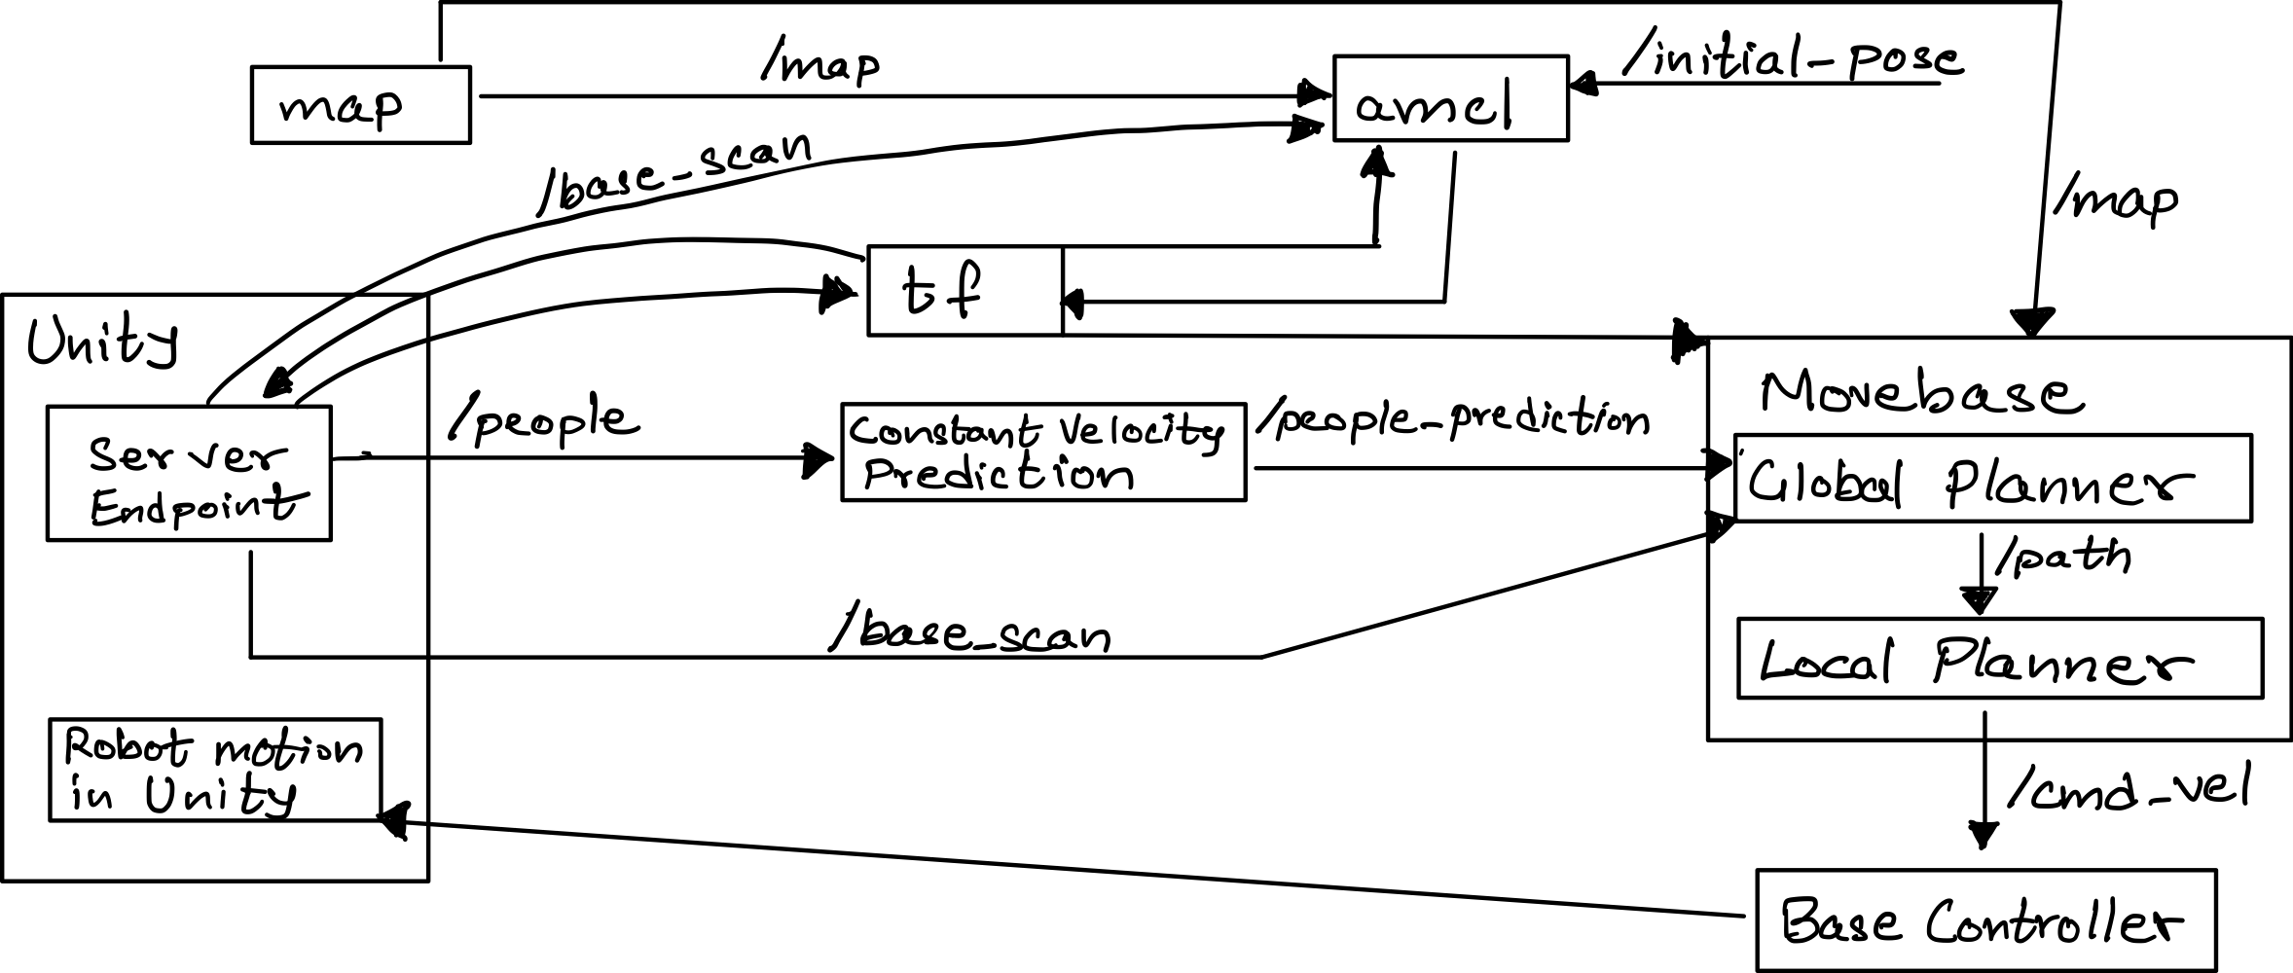
Flow Diagram
Notes:
This is how the rqt graph looks like.
(Will be explained by denny)

Slide 34
5
Experiments

Slide 35
Experiment Comparison
V/S
Global Planner and TEB Local Planner
TB Lattice Planner and Timed Path Follower
Notes:
Since we are doing a comparative analysis of Global Planner and TEB Local Planner with TB Lattice Planner and Timed Path Follower, let’s now take a look at the experiments.

Slide 36
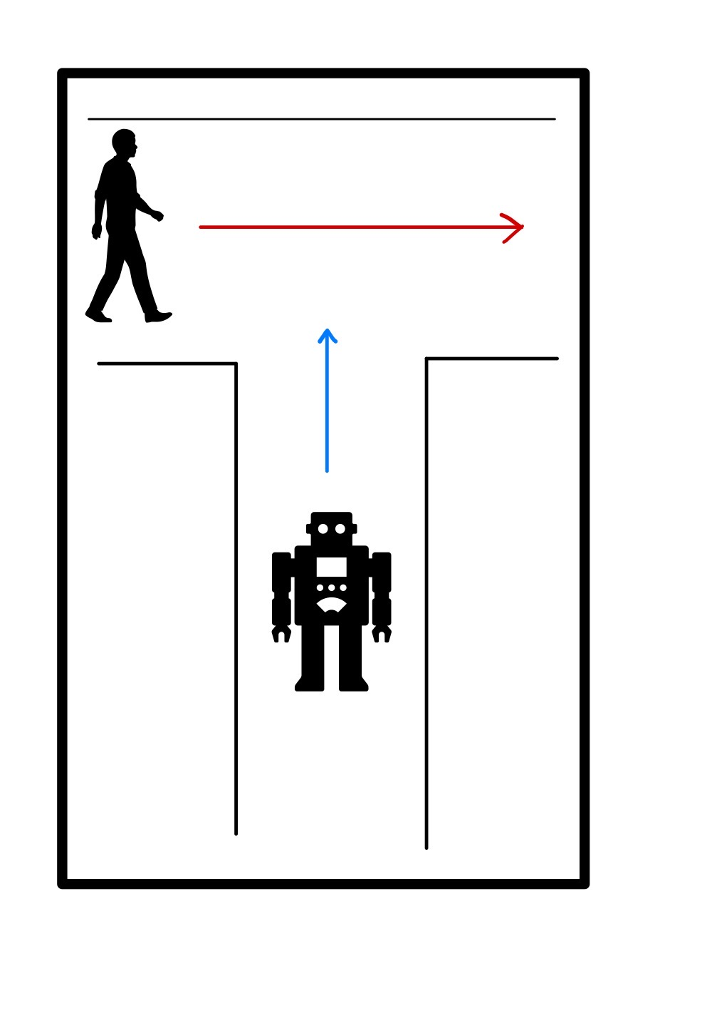
Experiment 1
Experiment 1:
Robot navigating in an intersection space where humans are crossing the robot’s path.
Evaluation Metrics:
Optimality of the global path planned.
Optimality of the local planner to plan a new path.
Obstacle avoidance i.e., check for collisions
Human-social aspects i.e., how close is the robot to the human.
Notes:
In this experiment our robot is navigating in an intersection where humans cross the robot’s path.

Slide 37
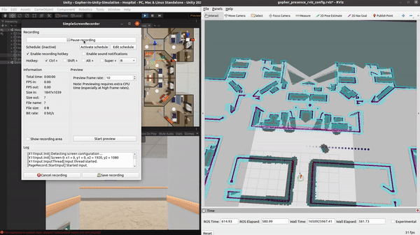
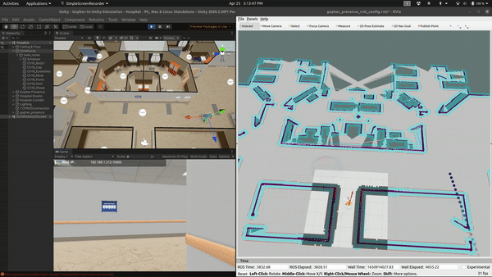
Experiment 1 Comparison
Global Planner and TEB Local Planner
TB Lattice Planner and Timed Path Follower
Notes:
Here is a comparison demo of the planners for experiment 1
TEB - red, we can also see how TEB planner visualizes the human as a static obstacle changing over time, by observing the lag in Rviz.
Lattice planner - yellow with trajectories
Social cost map - blue could
The blue array of dots is the predicted positions of the human.
In all our experiments we try to get failure cases as it would help validate our approach. And our failure case is getting the robot to collide with the human.

Slide 38
Experiment 1
TEB Planner Timed Path Planner
Test Case | Collision | Path Length | Min. Dist to Human | Collision | Path Length | Min. Dist to Human
1 | No | 4.942 | 1.233 | No | 4.858 | 1.916
2 | Collision | 5.019 | 0.634 | No | 4.892 | 1.244
3 | No | 5.079 | 1.241 | No | 4.720 | 1.382
4 | Collision | 5.074 | 0.684 | No | 4.879 | 1.217
5 | Collision | 5.180 | 0.587 | No | 4.695 | 1.470
6 | No | 4.957 | 1.545 | No | 4.922 | 1.331
7 | No * | 4.808 | 0.649 | No | 4.957 | 1.270
8 | No | 5.098 | 1.584 | No | 4.717 | 2.123
9 | Collision | 5.355 | 0.812 | No | 4.918 | 1.268
10 | Collision | 5.586 | 0.587 | No | 4.683 | 1.179
Avg 5.109 0.955 4.824 1.440
Notes:
This table shows 10 different test cases conducted for each set of planners, as we can see it is very obvious that timed path planner outperforms TEB when it comes to avoiding collisions with humans with an average min. Dist of 1.44m
In test case 7 we can see that the min dist to human is 0.649, this usually leads to a collision but in this case the human comes very close to the robot but due to the way we setup our experiment the human stops just before colliding.

Slide 39
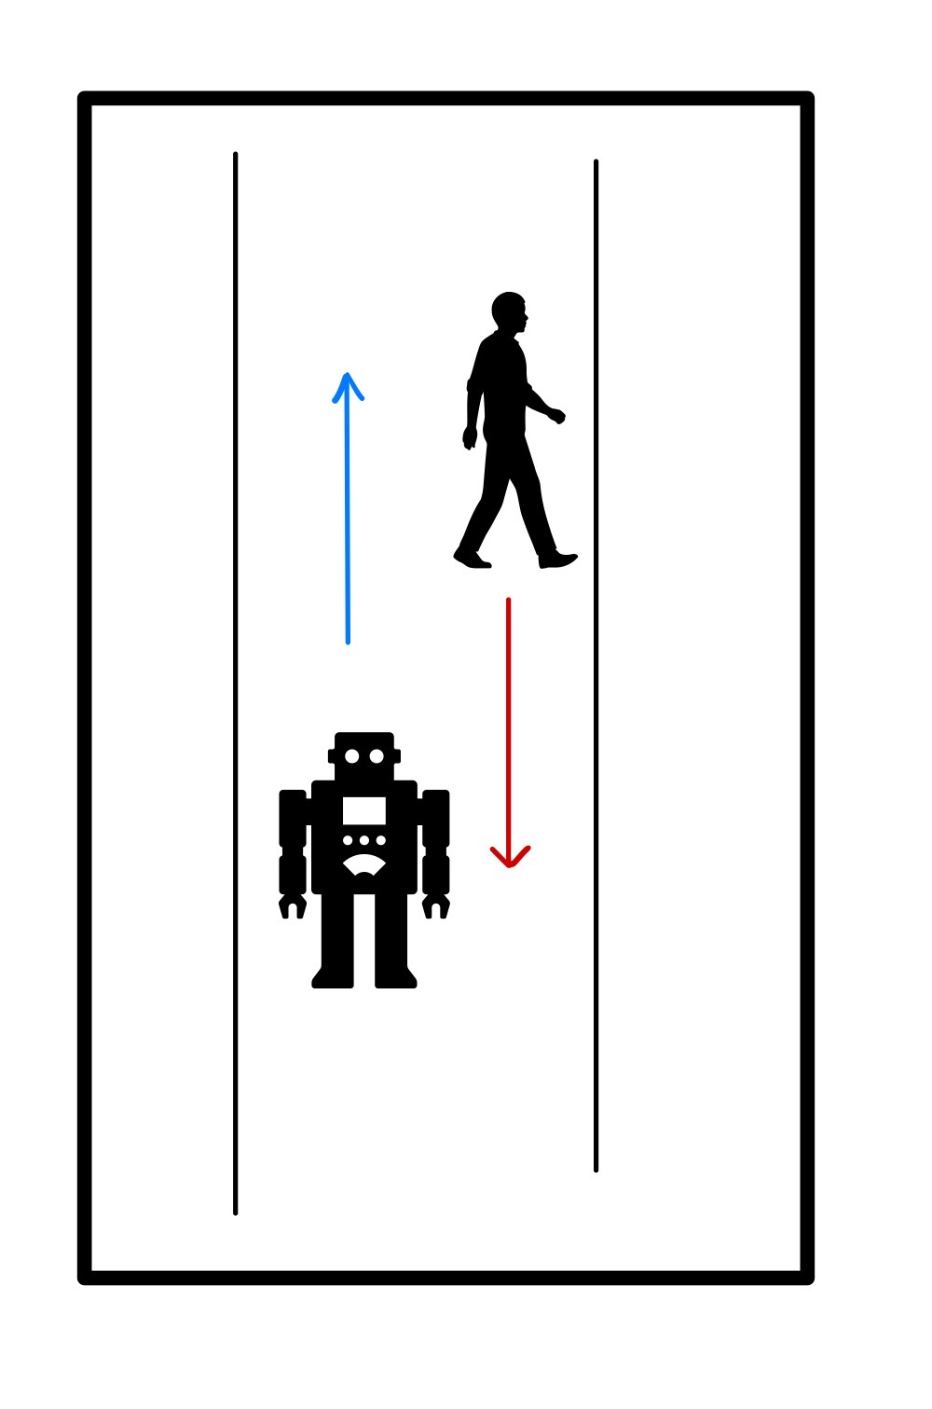
Experiment 2
Experiment 2:
Robot navigating in corridor with humans walking parallel and opposite to the robot’s direction.
Evaluation Metrics:
Optimality of the global path planned.
Optimality of the local planner to plan a new path.
Obstacle avoidance i.e., check for collisions
Human-social aspects i.e., how close is the robot to the human.
Notes:
In this experiment our robot navigates parallel to the human’s path in a corridor, the robot can either be navigating opposite to the human or in the same direction.

Slide 40
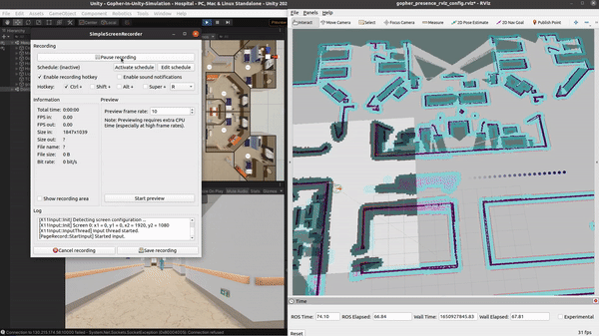
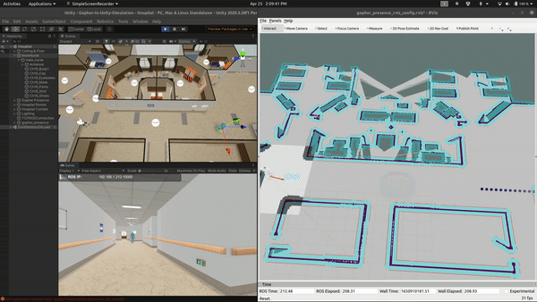
Experiment 2 Comparison
Global Planner and TEB Local Planner
TB Lattice Planner and Timed Path Follower
Notes:
Here is a Demo of the experiment 2. To test the robustness of the planner we create scenarios where the
Robot moves in opposite direction to the human
Robot moves in front of the human
Robot moves behind the human
Robot moves alongside the human

Slide 41
Experiment 2 Table
TEB Planner Timed Path Planner
Test Case | Collision | Path Length | Min. Dist to Human | Collision | Path Length | Min. Dist to Human
1 | No | 19.069 | 0.777 | No | 19.531 | 0.928
2 | No | 19.133 | 0.780 | No | 20.387 | 0.957
3 | Collision | 19.390 | 0.573 | Collision | 19.50* | 0.90*
4 | No | 19.323 | 0.776 | No | 19.896 | 1.045
5 | No * | 19.099 | 0.634 | No | 19.387 | 0.872
6 | Collision | 19.231 | 0.646 | No | 19.405 | 0.886
7 | No | 19.036 | 0.724 | No | 19.175 | 0.828
8 | No | 19.391 | 0.834 | No | 19.548 | 0.717
9 | No | 19.190 | 0.719 | No | 19.492 | 0.874
10 | No | 19.305 | 0.616 | No | 20.345 | 1.114
Avg 19.216 0.707 19.666 0.912
Notes:
Just like in experiment 1, we conducted 10 different test cases for the planners, here we can clearly see that the timed path planner gives us better min. distance to the human and as a result it increases the total path length.

Slide 42
Experiment 3
Experiment 3:
Robot navigating in a hospital environment with static and dynamic obstacles.
Evaluation Metrics:
Optimality of the global path planned.
Optimality of the local planner to plan a new path.
Obstacle avoidance i.e., check for collisions
Human-social aspects i.e., how close is the robot to the human.

Slide 43
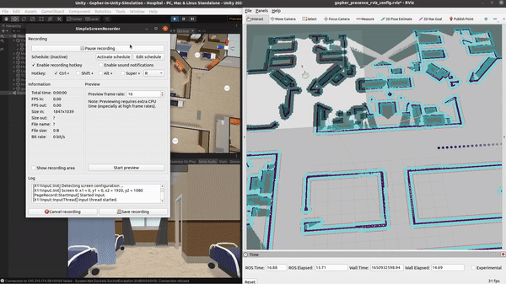
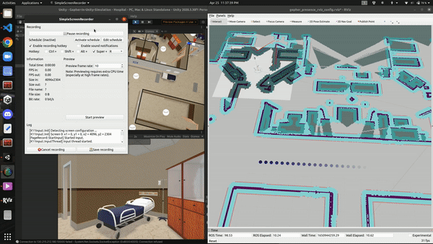
Experiment 3 Comparison
Global Planner and TEB Local Planner
TB Lattice Planner and Timed Path Follower
Notes:
To check for robustness of our implementation we navigate the robot through 3 paths, each path tests the robots capability to avoid new obstacles introduced in the scene as well as a moving human.
In this simple setup we can see a sofa and a bed introduced in the scene.
We have conducted tests where we place other obstacles such as trash cans and IV stands, and we came across a few shortcomings and failure cases which will be discussed in an upcoming slide.

Slide 44
Experiment 3 Table
TEB Planner Timed Path Planner
Test Case | Collision | Path Length | Min. Dist to Human | Collision | Path Length | Min. Dist to Human
1
a-b | No | 17.217 | 1.073 | No | 16.128 | 0.800
b-c | No | 11.527 | 2.558 | No | 11.737 | 1.69
c-d | Collision | 20.555 | 0.560 | No | 20.528 | 0.795
2
a-b | No | 17.199 | 1.251 | No | 16.509 | 0.825
b-c | No | 11.637 | 2.514 | Collision | 12.024 | 0.582
c-d | No | 19.986 | 0.617 | No | 19.821 | 0.649
3
a-b | No | 17.258 | 3.120 | No | 16.423 | 0.688
b-c | Collision | 12.287 | 0.584 | No | 12.770 | 0.994
c-d | Collision | 19.302 | 0.578 | No | 20.042 | 0.877
Notes:
For this experiment we conducted 3 tests. The three paths are a-b, b-c, and c-d.
This experiment is conducted to test the general capability to plan paths and avoid obstacles, we cannot use this table to analyse the social aspects of navigation as when we start our simulation, the position of the human would have changed, hence changing the path planned, but we do get an overall sense of which planner works best which is without a doubt timed path planner.

Slide 45
6
Results

Slide 46
Results
Exp 1 : lowest path length, highest min. distance to human
Timed local planner waits for the human to pass but TEB collides.
Exp 2: social navigation had highest distance to human, baseline had shortest path distance
Baseline always considers humans as static in a time step
Social navigation predicted future positions of humans and plans a path avoiding those.
Notes:
For experiment 1 we saw that social navigation had lowest path length and highest distance to human.
In experiment 1 we also saw that robot with social navigation waits for the human to pass while in baseline the robot tries to avoid and move which results in more collision as human is moving.
From Experiment 2 we can see that social navigation had highest distance to human while baseline had shortest path distance. This is expected because maintaining more distance from human will result in higher path length.
It was visible from experiments that baseline always considers humans as static in a time step and plans a path, by the time it moves along that path the human moves closer resulting in more collision.
It was visible from experiments that social navigation predicted future positions of humans and planned a path avoiding those future positions thus resulting in less number of collisions.

Slide 47
Failure Cases
Blindspot
Velocity of the Robot
Limited field of view, hinders robot’s detection ability
The robot is able to replan fast enough, but the robot’s velocity is not high enough to avoid the human.
No path found
Robot is not able to find a path when human is approaching
Initial Error
Sensing
Robot collides when human is too close to the robot and a goal is given
Lidar scans sometimes miss narrow objects
Notes:
When we place a IV stand in the environment and try to make the robot navigate around it, most of the time the robot crashes into it, we found that since the Lidar is placed at a height from the ground, it scans the IV stand as a point/pixel and builds a costmap around that point/pixel. This point/pixel doesn’t not have the dimensions of the base included and hence the robot crashes into the base of the IV stand.

Slide 48
7
Devices
Notes:
Now we will see some tools we will be using for this project

Slide 49
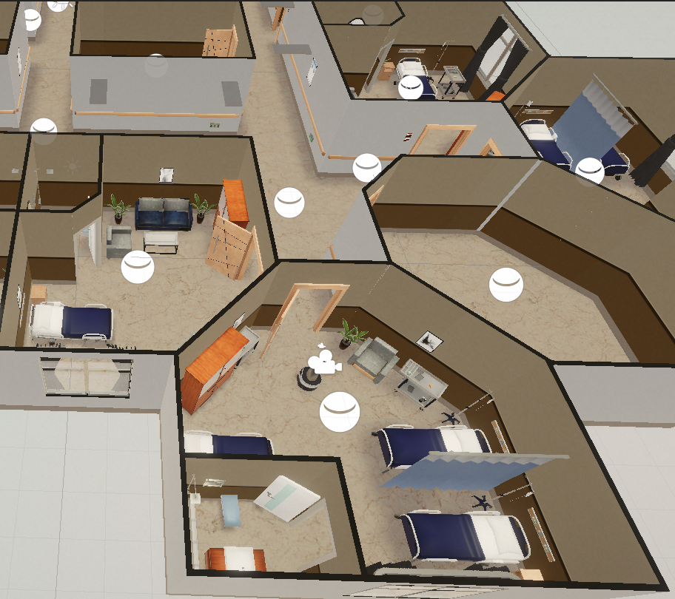
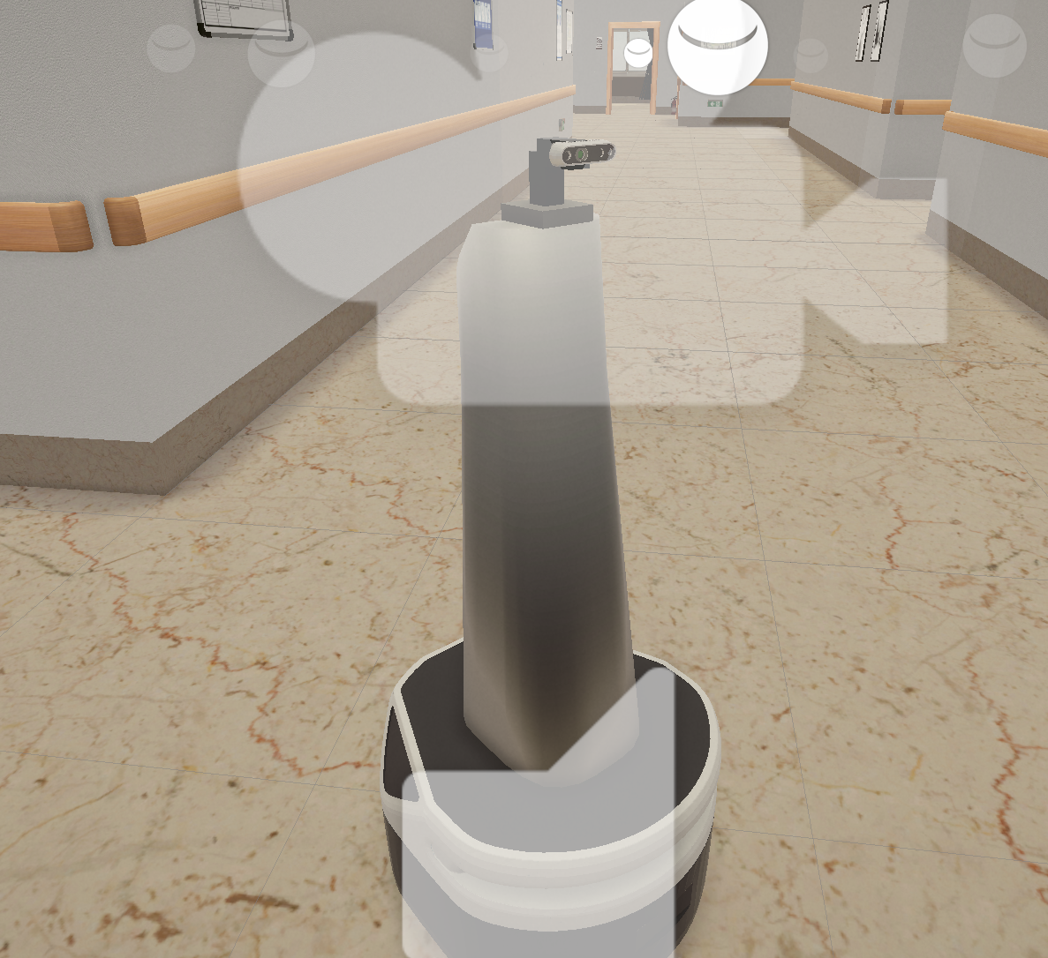
Devices
Simulation: Unity Engine (Hospital Scenario)
Robot: Gopher Presence
Tools: ROS, Gmapping, Python, C++
Notes:
For simulation we are using Unity with a Gopher Presence Robot. Also, we will be using ROS with Python and C++ along with the Gmapping package

Slide 50
8
Objectives For Learning

Slide 51
Objectives For Learning
Knowledge Learning | Skill Learning
Basic concepts of ROS and Unity | Integrating ROS with Unity
Structure of navigation stack | Integrating navigation stack for our robot
Working of slam_gmapping, required inputs for mapping and its output | Mapping the hospital scene in unity
Working of TEB, DWA, Lattice, Timed Path Follower Planners | Integration, working and tuning of used navigation planners
Understand various evaluation metrics | Using these metrics for evaluation of our experiments
Notes:
The table shows our learnings through this project. We have understood the working of ROS and Unity along with a study of the navigation stack. We have an understanding of TEB local planner and will proceed to its implementation. Lastly, we will use the evaluation metrics we have studied on our implementation to understand and compare the efficiency of our algorithm.

Slide 52
9
Deliverables

Slide 53
Deliverables
Baseline:
Task:
Robot navigating in an intersection space where humans are crossing the robot’s path.
Robot navigating in corridor with humans walking parallel and opposite to the robot’s direction.
Robot navigating in a hospital environment with static and dynamic obstacles.
Motion Planning:
Integrate an Optimal Global Planner
Integrate a Local Planner for human aware navigation
Compare performance of the implemented planners with TEB local planner
Analysis between normal navigation and social navigation
Comparison of global path length
Comparison of closeness to human
Stretched Goal:
Smoothening the planned path
Improve dynamic obstacle avoidance
Notes:
The deliverables for our project are mentioned here. The baseline tasks involve implementing a Optimal Global Planner and a Local Planner to avoid dynamic obstacles. This will involve various tasks that the robot will perform, such as interacting with humans when they cross the robot’s path, or when they cross the robot in the hallway. The extended goals for our project are to smoothen the planned path, and improve dynamic obstacle avoidance.

Slide 54
10
Team and Task Division

Slide 55



Team
DENNY BOBY
NIHAL SUNEEL NAVALE
ANIKET PATIL
Notes:
This is our team: Denny, Nihal and Aniket.

Slide 56
Task Division
Week | Aniket | Denny | Nihal
Week 1-2 | Literature Review
Week 3-4 | Unity Simulation Setup, Familiarize with ROS
Week 5-6 | Generate Map, Integrate Global and Local Planner for base comparison, Project Proposal Report and Slides
Week 6-7 | Integrate lattice planner(global planner) for the generated map
Week 8-9 | Integrate timed path follower(local planner) for dynamic obstacle avoidance and social navigation
Week 10-11 | Experiment 1 | Experiment 2 | Experiment 3
Week 12 | Buffer week
Week 13 | Write Evaluation Scripts and testing
Week 14 | Report, PPT and Presentation
Notes:
This table shows the progress and future timeline of the project along with the task division we have in mind. Currently we have achieved the targets mentioned in Week 6.

Slide 57

Thanks!
Github Link: https://github.com/dennyboby/human_aware_robot_navigation
Q&A
Notes:
Here, you can see the github link to our project. We hope you find our work interesting and follow the progress. Thank you!

